Slide 1
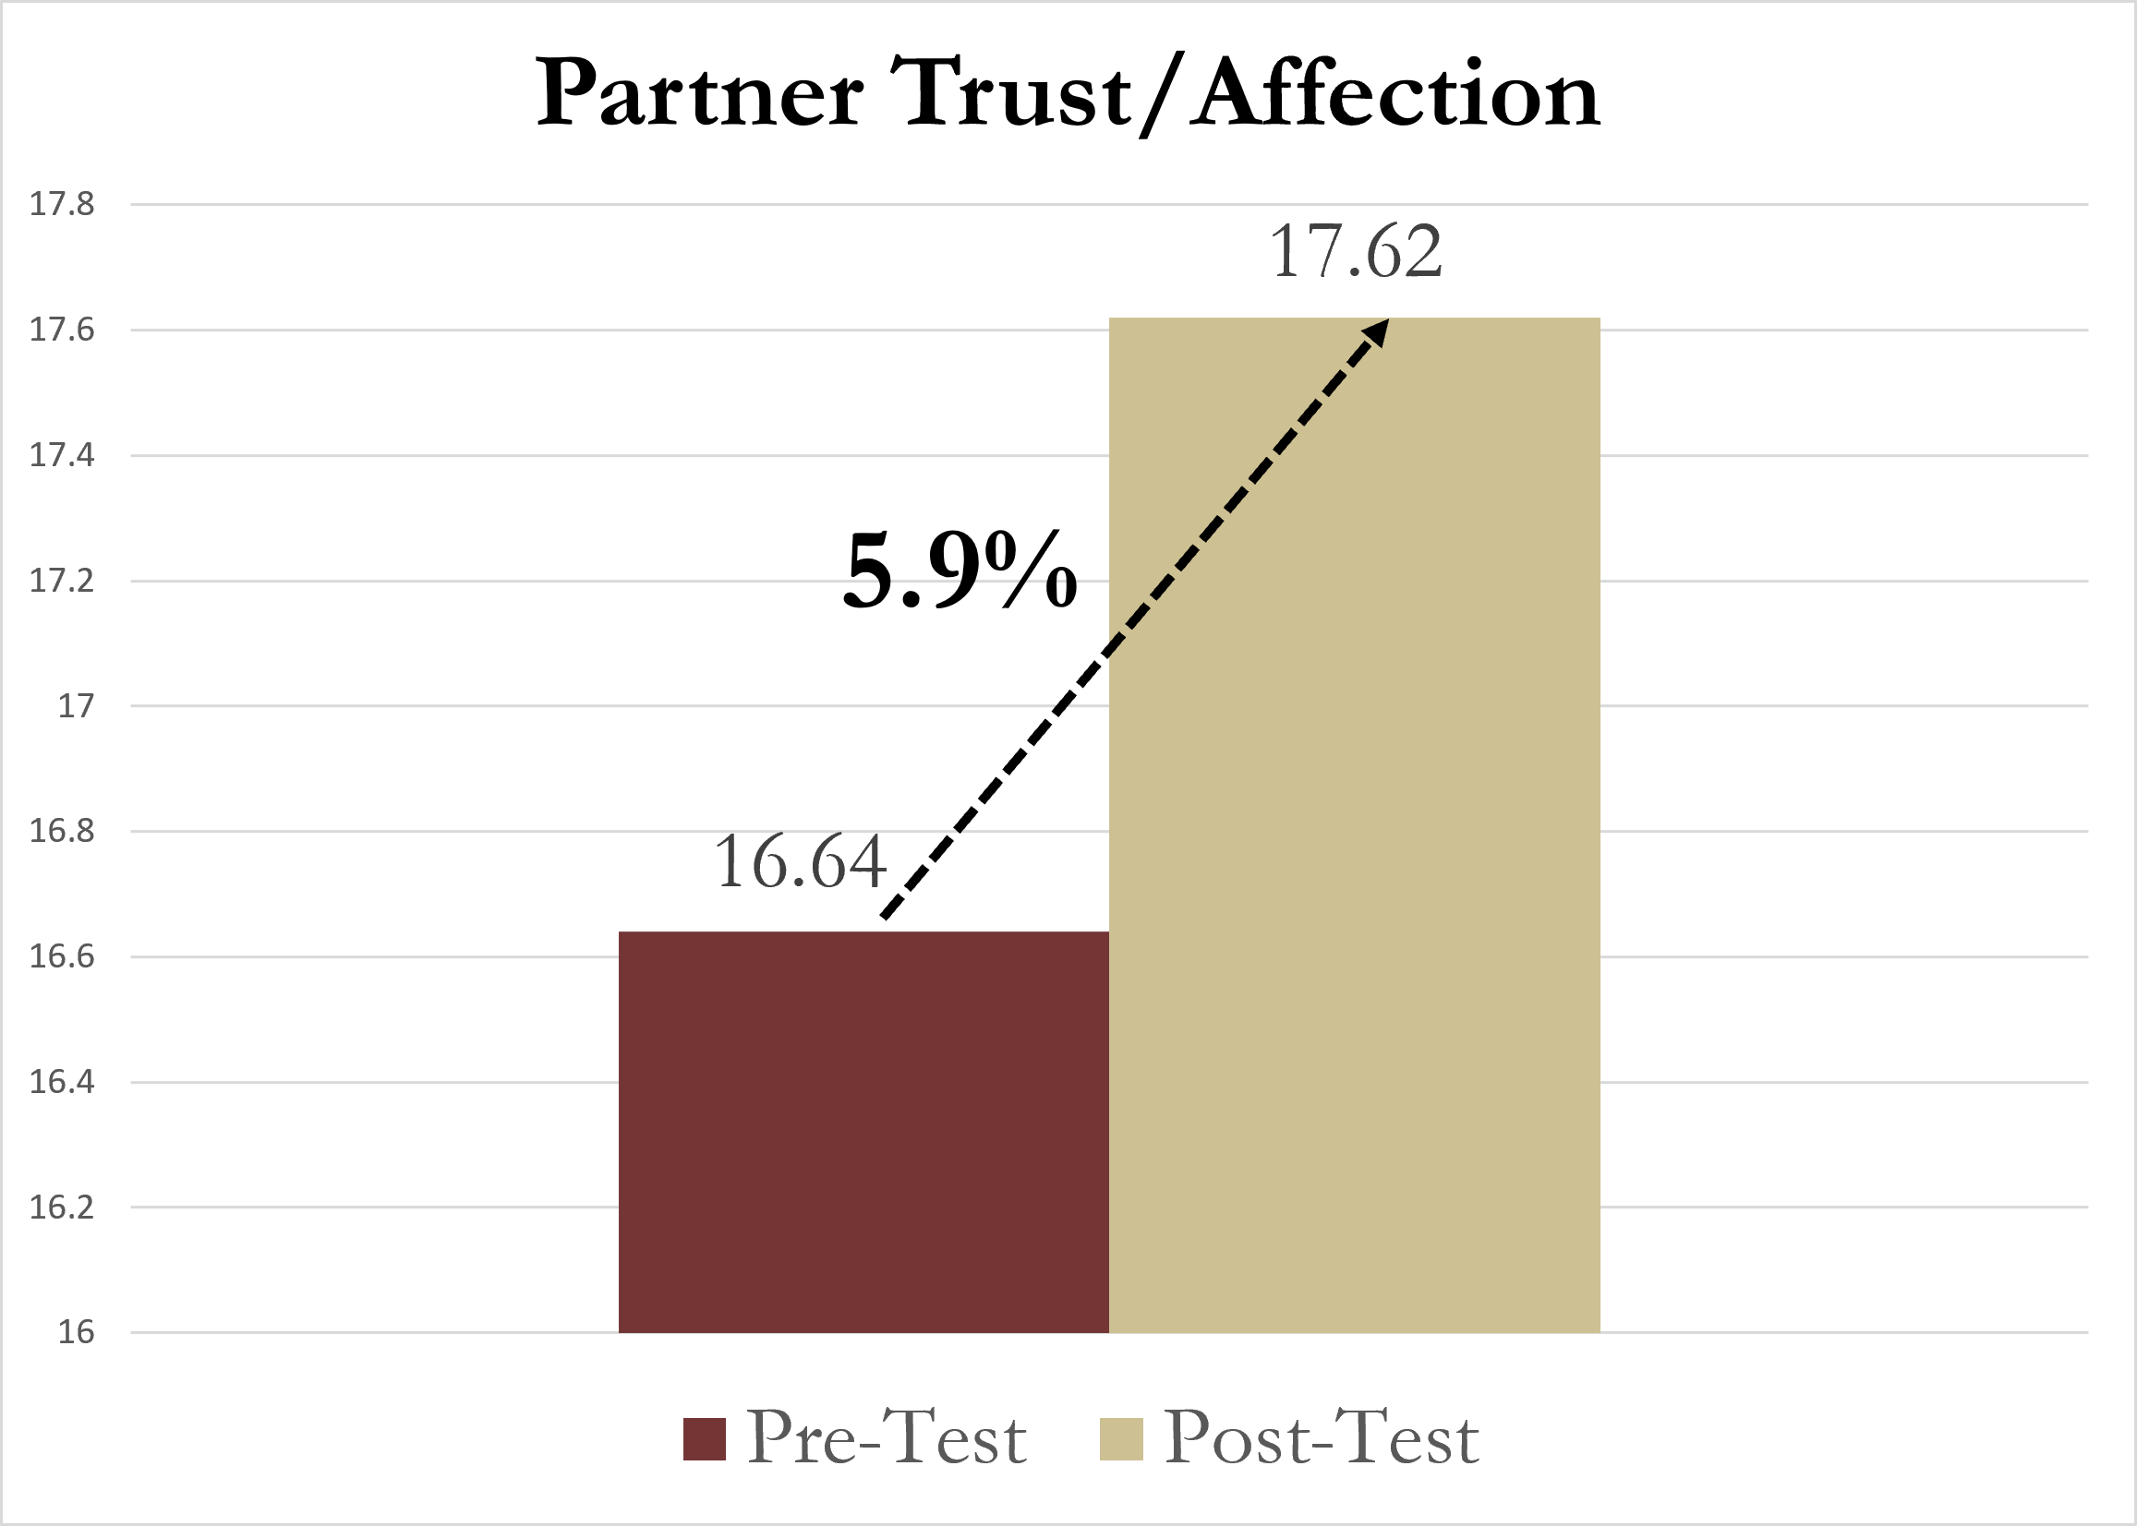
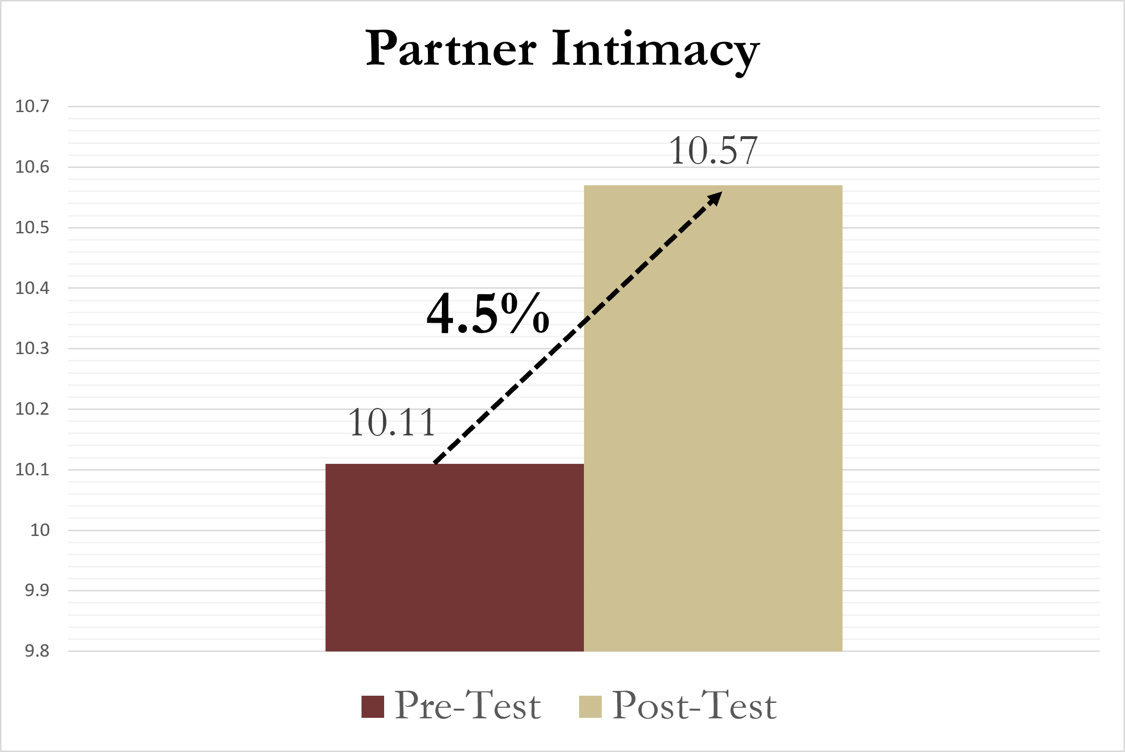
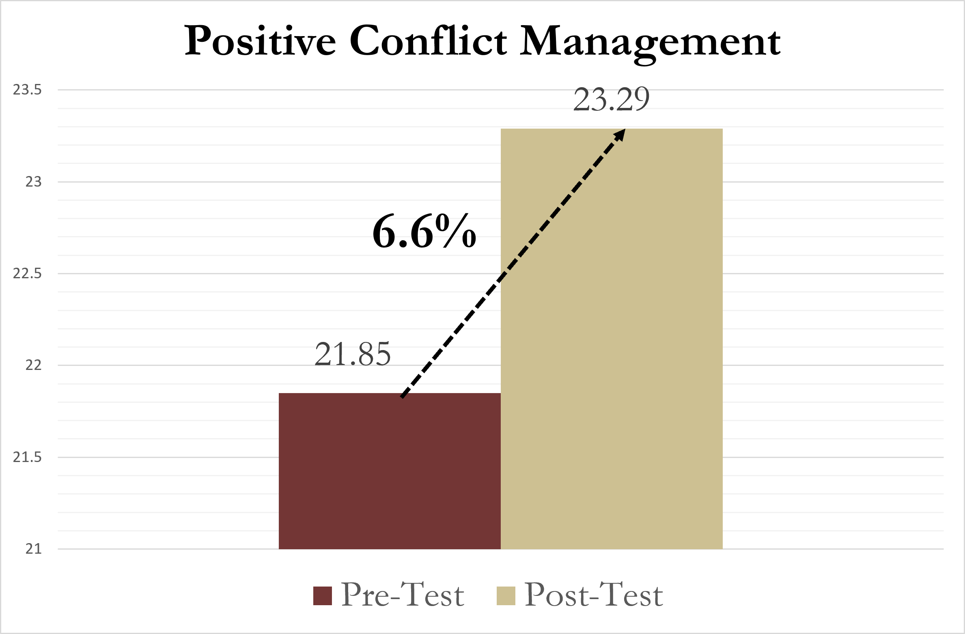
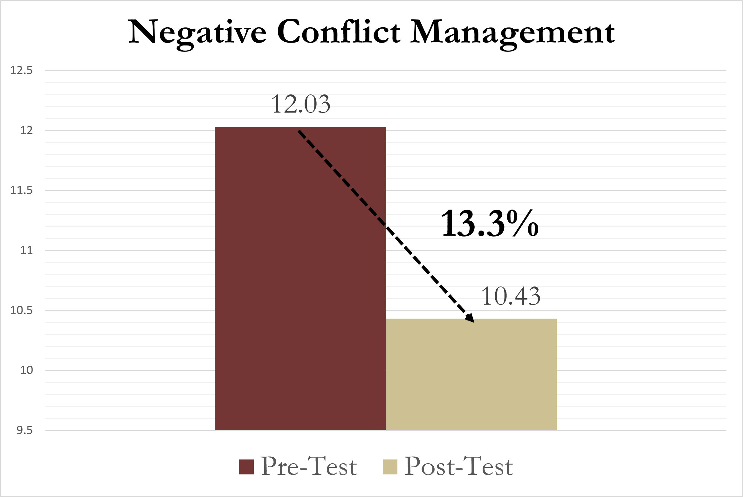
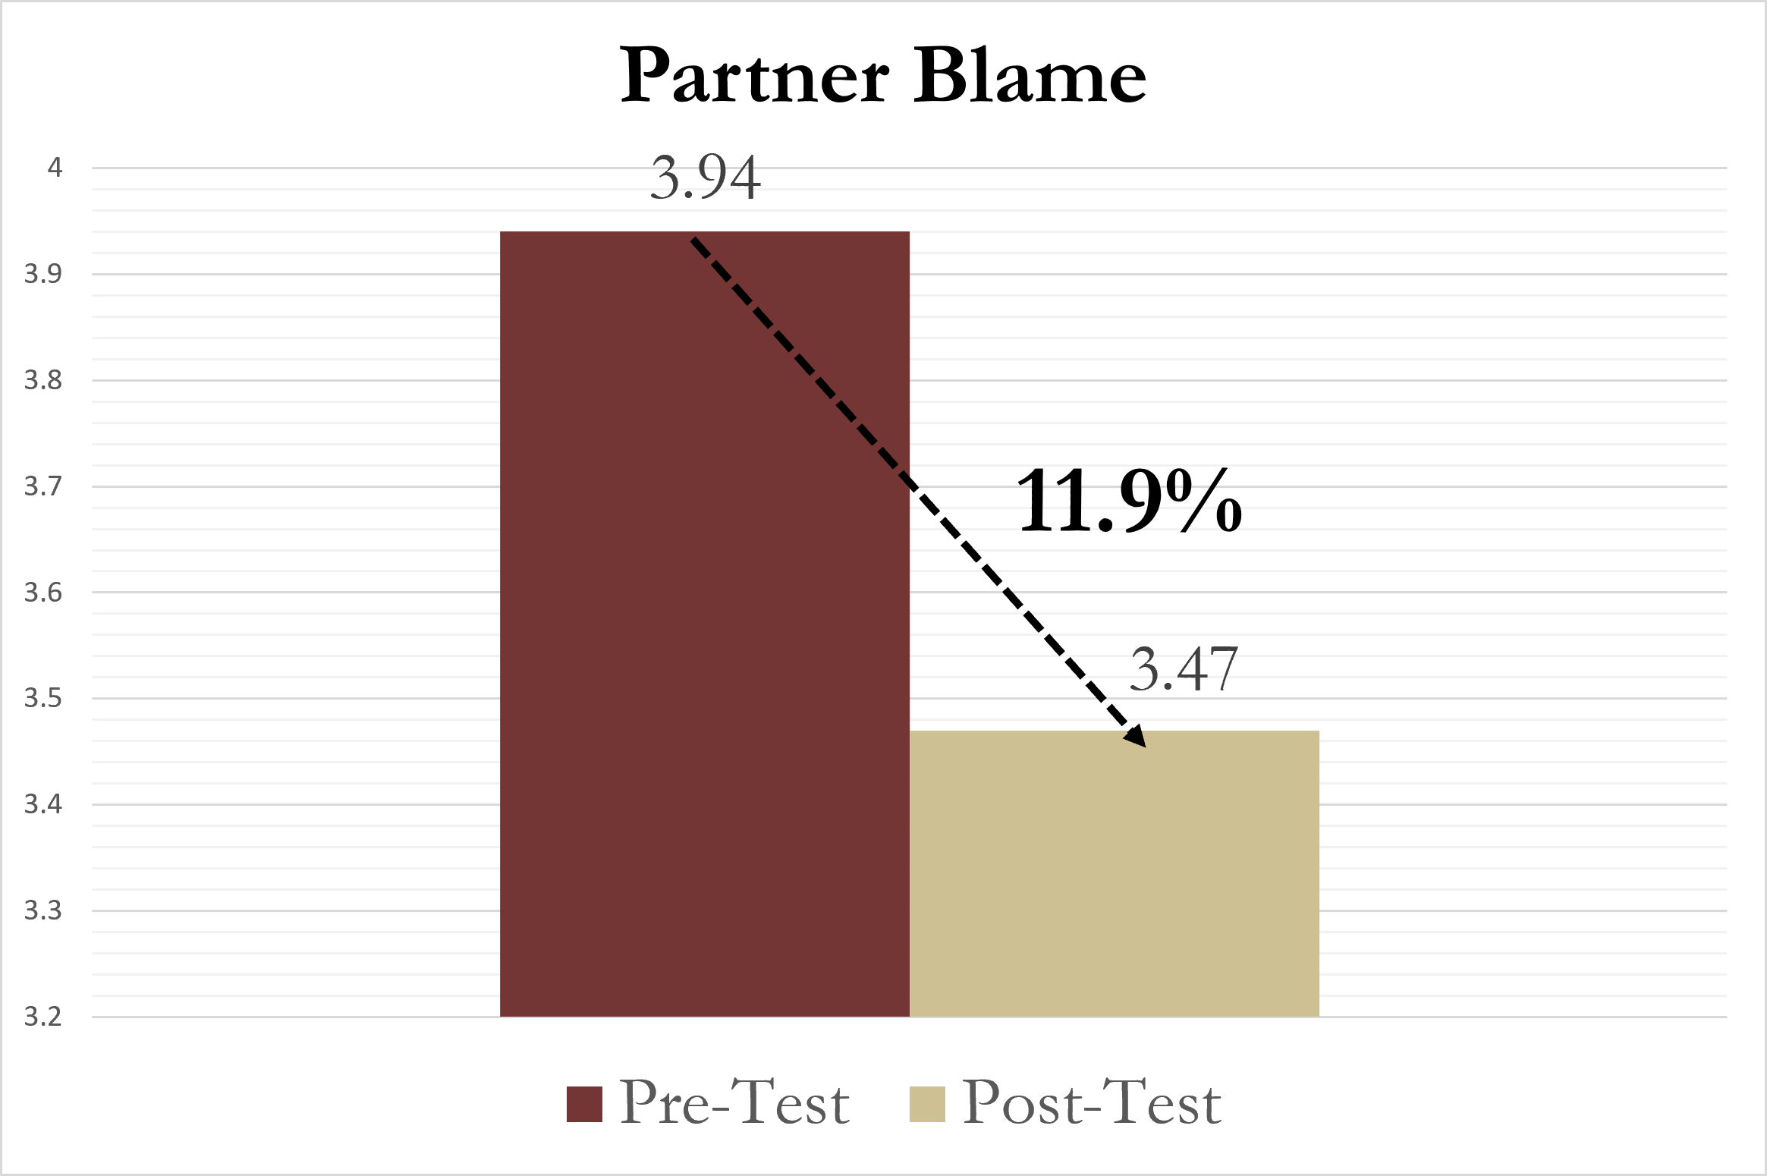
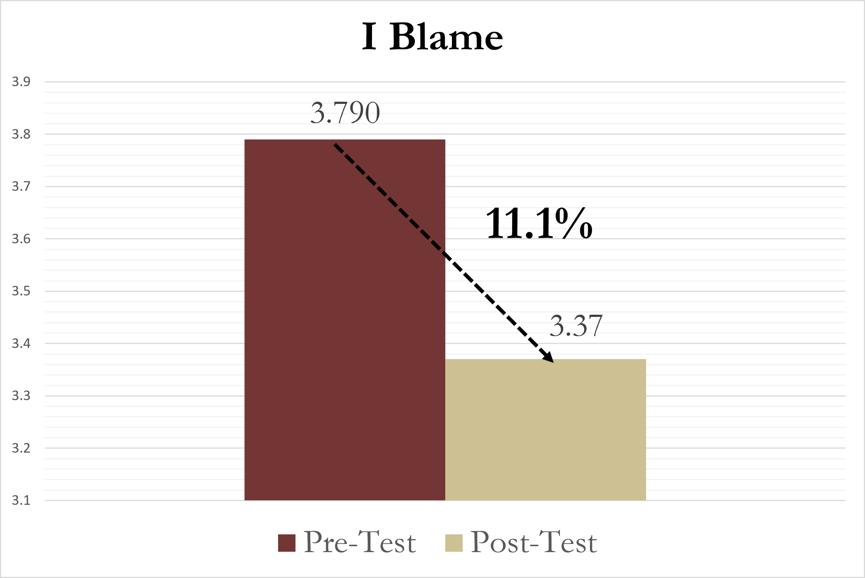
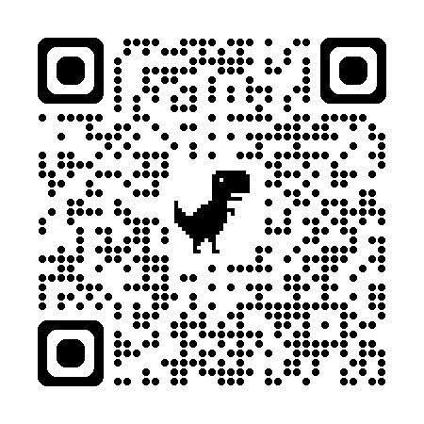
Investing in Healthy Relationships: Evaluating the Effectiveness of Marriage Education Program
Izbeth Flores¹, Kaley de Leon¹, Hye-Jung Yun¹, Cynthia B. Wilson¹
¹Florida State University
INTRODUCTION
RESULTS
Background: Participating in marriage and relationship programs fosters effective communication and conflict resolution skills, thereby promoting overall relationship quality and nurturing a healthier family environment (Parker, 2007). Family systems theory (Bowen, 1978) posits interconnectedness between marital quality and family functioning, highlighting the importance of addressing and nurturing the marital relationship as a foundational element in promoting the well-being of the entire family system. Therefore, it is imperative to understand the effectiveness of marriage education programs and how they influence marital quality and stability, which has the potential to create more stable, healthy environments for children.
Aims & Goals: The purpose of this study is to evaluate the effectiveness of the skills-based marriage education program, Adventures in Marriage (AIM) among married couples. Through the enhancement of partner affection and intimacy alongside improvements in effective conflict management abilities, the AIM program empowers couples with essential resources for navigating adversity and fostering enduring, healthy relationships.
Figure 1. Partner Trust/Affection Mean Change (t= –22.85, p<.001)
Figure 2. Partner Intimacy Mean Change (t= –15.97, p<.001)
Participation in the AIM program resulted in a significant increase of partner trust and affection, reflecting a positive transformation in the emotional dynamics between couples.
Couples who engaged in the AIM program significantly improved in partner intimacy, fostering a deeper emotional connection.
There was a significant increase in positive conflict management behaviors and a notable decrease in negative conflict management behaviors, indicating an enhanced capacity among couples to resolve and manage conflicts healthily.
High-risk conflicts significantly decreased after participating in the AIM program, supporting healthier relationship behaviors.
CONCLUSION
The findings reveal significant enhancements in couples' relationships, particularly in areas such as partner trust/affection, intimacy, and conflict management.
Participants demonstrated improved abilities to engage in positive conflict resolution, with a notable reduction in high-risk conflicts, indicating a healthier dynamic within their relationships. This aligns with Parker's (2007) assertion that effective communication and conflict resolution skills foster overall relationship quality, nurturing a healthier family environment.
The AIM program not only equips couples with essential skills for navigating adversity but also supports the idea that strong marital relationships contribute to stable, healthy environments for children.
PARTICIPANTS
We utilized data from the Florida Center for Prevention Research, collaborating with a local non-profit organization serving Florida residents. The study included 1,477 different-sex married couples who voluntarily participated in a 12-hour marriage education program. Participants completed a series of confidential surveys at baseline and upon program completion.
Demographics:
Ethnicity: 71% White; 29% Hispanic or Latino
Mean Age: 45.47 years
All procedures were approved by an academic institutional review board. This research is part of the federal Healthy Marriage and Relationship Education (HMRE) grant (HHS-2020-ACF-OFA-ZB-1817).
Figure 3. Positive Conflict Management Mean Change (t= –22.39, p<.001)
Figure 4. Negative Conflict Management Mean Change (t= 26.70, p<.001)
IMPLICATIONS
By equipping couples with effective communication and conflict resolution skills, AIM empowers them to navigate challenges and sustain healthy relationships.
An emphasis on instructor-led interactive couple relationship education is a promising practice that further equips couples with the skills necessary to enhance healthy relationship behaviors.
Such initiatives not only promote family well-being but also serve as preventive measures against marital distress and divorce.
Advocating for increased funding and resources for marriage education programs is crucial in fostering happier and healthier families within our communities. Investing in these initiatives highlights the importance of prioritizing the strengthening of familial ties, ultimately contributing to the cultivation of resilient and thriving family units and children.
METHODS
Analyzed using paired samples t-tests in SPSS 28.
Measures
Partner Trust/Affection. Five items measured partners' trust and affection on a four-point Likert scale (1 = strongly disagree to 4 = strongly agree). A sample item is: “My partner expresses love and affection towards me.”
Partner Intimacy. Three items were used to measure partner intimacy on a four-point Likert scale (1 = less often to 4 = almost every day). A sample item included “In the past month, how often have you participated together in an activity you both enjoy?”
Positive Conflict Management. Seven items assessed positive conflict management, rated on a 4-point Likert scale (1 = never to 4 = often). A sample item is: “During an argument, my partner and I were good at taking breaks when needed.”
Negative Conflict Management. Five items measured perceptions of negative conflict management, rated on a 4-point Likert scale (1 = never to 4 = often). A sample item is: “Small issues suddenly became a big argument.”
Partner Blame. Two items assessed perceptions of “partner blame” in high-risk conflict: “My partner blamed me for his/her problems” and “My partner yelled or screamed at me.” Items were rated on a 4-point Likert scale (1 = never to 4 = often).
I Blame. Two items measured “I blame” in high-risk conflict: “I blamed my partner for his/her problems” and “I yelled or screamed at my partner.” These used the same 4-point Likert scale.
Figure 5. Partner Blame Mean Change (t= 16.92, p<.001)
Figure 6. I Blame Mean Change
(t= 15.95, p<.001)
Let’s Connect!
Have questions or want to discuss my research?
I’d love to hear from you!
Izbeth Flores Aparicio Research Assistant Florida Center for Prevention Research iaf20@fsu.edu
Scan the QR code below to access our publications!

